Slide 1
Quality of Life…Insurance
AIG Partners Group Product Overview
Policies issued by American General Life Insurance Company ("AGL“), Houston, TX, Member of American International Group, Inc. (AIG)
Notes:
Read Slide

Slide 2
QoL Advantage—Laddering Policies to Save Money
Notes:
Read Slide

Slide 3
QoL Advantage
Laddering—See It In Action
Larry, age 39, has two children ages 5 and 8. His goals are to purchase life insurance to provide for his family in the following situations:
$250,000 of coverage on himself until his youngest child reaches age 21
$500,000 of coverage until retirement at age 62 to protect his family’s income needs
$250,000 of coverage to pay off his mortgage, which has 27 years remaining
This hypothetical example is for illustrative purposes only. Not an actual case and intended solely to depict how the product features might work.
Notes:
Read Slide

Slide 4
QoL Advantage
Laddering—See It In Action
Larry could buy a single $1 million policy, but the closest term period offered by other companies would be 30 years.
$1 million 30 year QoL Flex Term = $1,385 annual
 | Purpose | With QoL Advantage
16 Year 250k DB | Youngest Child Reaches Age 21 | $145
23 Year 500k DB | To Retirement | $470
27 Year 250k DB | Mortgage Protection | $360
Total |  | $975
Initial Annual Savings:
$310
This hypothetical example is for illustrative purposes only. Not an actual case and intended solely to depict how the product features might work.
Notes:
Read Slide

Slide 5
QoL Advantage
Laddering—See It In Action
Even if Larry canceled his 30 year term policy after his total 27 year needs had expired:
$32,125 in total premium
Total premiums paid into 3 individual term policies:
$22,850
$9,275
Savings!
This hypothetical example is for illustrative purposes only. Not an actual case and intended solely to depict how the product features might work.
Notes:
Read Slide

Slide 6
QoL Guarantee Plus GULII
Competitive GUL with post-issue flexibility
Policies issued by American General Life Insurance Company ("AGL“)
Notes:
Read Slide

Slide 7
QoL Guarantee Plus GUL II
Flexibility & Choice
Male, Age 65, PNT, Guaranteed to 105¹
Face:
$1MM Guaranteed to 105¹
Annual Premium:
$22,361
Guaranteed Cash at 85
$138,974
Face:
$499,998 Guaranteed to 105¹
Annual Premium:
$11,840
Guaranteed Cash at 85
$77,682
50% Withdrawal at 85:
$69,487
Differentiated Partial Withdrawal Capability Allows You To
Access Cash and Preserve Death Benefit Guarantee
Not an actual case. Presented for illustrative purposes only.
Quote dated 09/07/2018 .
The reduction in specified amount will be subject to the same guidelines and restrictions as outlined in the policy. The resulting remaining death benefit amount must be no less than $50,000.
Notes:
Read Slide

Slide 8

QoL Guarantee Plus GUL II
Guaranteed Return of Premium (ROP)
Enhanced Surrender Value Rider
If your clients’ needs change or they no longer need coverage, the new Enhanced Surrender Value Rider provides two options for surrendering the policy and recouping paid premiums – 50 percent in year 20 or 100 percent in year 25.
The Enhanced Surrender Value (“ROP”) is capped at 40% of specified face amount; for example, the benefit under a policy with a $1,000,000 specified amount could never be greater than $400,000.
This hypothetical example is for illustrative purposes only. Not an actual case and intended solely to depict how the product features might work.
Notes:
Read Slide

Slide 9
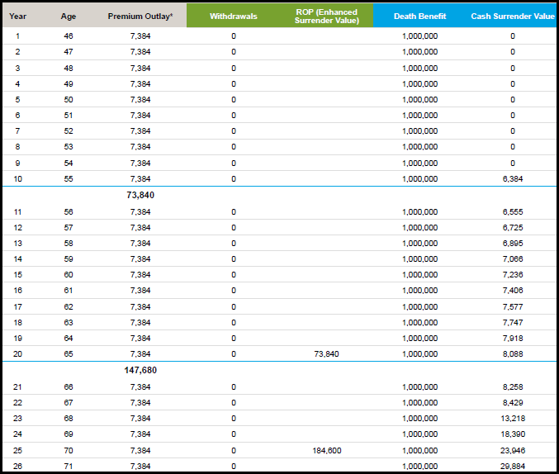
QoL Guarantee Plus GUL II
Enhanced Surrender Value Rider (Return of Premium)
Hypothetical information for illustrative purposes only.
Notes:
Read Slide

Slide 10
Lifestyle Income Solution (LIS) Rider
Lifestyle Income Solution: Longevity Insurance
Accelerate up to 10% of DB per year
Primary requirement: Live to age 85
Tax-free up to basis; ordinary income after
Choosing to exercise rights under the Lifestyle Income Solution can impact cash available under the Accelerated Access Solution.
Please speak with your American General Life Insurance Company representative for more information.
Notes:
Read Slide

Slide 11
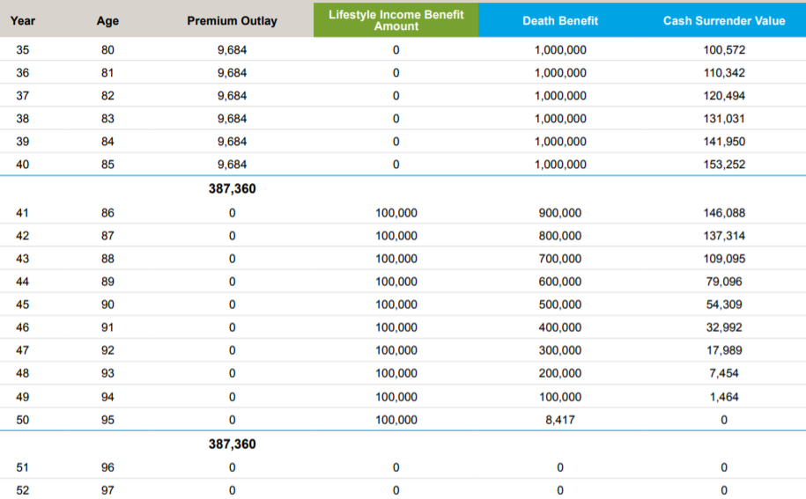
LIS Example
Hypothetical information for illustrative purposes only.
Notes:
Read Slide

Slide 12
10-10-10 Sales Idea
Notes:
Read Slide

Slide 13
Scenario
    George, 50 years old
    Looking for $1 million of coverage for his family
    Wants to provide life insurance for his spouse well into retirement, but sees that need dropping as he approaches the latter retirement years
    He is also concerned about the impact of a chronic illness hon his retirement.
This hypothetical example is for illustrative purposes only. Not an actual case and intended solely to depict how the features might work. It does not reflect the value of any specific policy. Restrictions and limitations apply.
For the purpose of easing the explanation, all numbers have been rounded. The QoL Guarantee Plus II product solution is based on an illustration dated 04/16/18 for a 50 year old male, preferred non-tobacco with premiums paid for 10 years and a death benefit guaranteed to age 100. The policy included the approximately $25,000 of Lifestyle Income Solution rider, beginning at age 70 and a 100% Accelerated Access Solution rider with a 2% monthly benefit.
Notes:
The Value+ Protector offers innovative provisions for accessing excess cash value in the policy without reducing initial death benefit and in some cases increasing the death benefit.
Other options include living benefits that accelerate the death benefit, thus protecting other family assets from being depleted to support a chronic illness.
Strong Index Performance Feature
Excess Funding Feature
Accelerated Access Solution
Select Income Rider
Premium Protection Rider

Slide 14
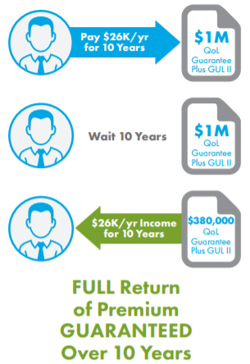
10-10-10
    He pays $26k per year for 10 years
    Then, he pays nothing for 10 years
    Next, he takes $26k per year out of the policy (tax free!) using the Lifestyle Income Solution Rider
    The withdrawal reduces the life insurance coverage to $380,000
This hypothetical example is for illustrative purposes only. Not an actual case and intended solely to depict how the features might work. It does not reflect the value of any specific policy. Restrictions and limitations apply.
For the purpose of easing the explanation, all numbers have been rounded. The QoL Guarantee Plus II product solution is based on an illustration dated 04/16/18 for a 50 year old male, preferred non-tobacco with premiums paid for 10 years and a death benefit guaranteed to age 100. The policy included the approximately $25,000 of Lifestyle Income Solution rider, beginning at age 70 and a 100% Accelerated Access Solution rider with a 2% monthly benefit.
Notes:
The Value+ Protector offers innovative provisions for accessing excess cash value in the policy without reducing initial death benefit and in some cases increasing the death benefit.
Other options include living benefits that accelerate the death benefit, thus protecting other family assets from being depleted to support a chronic illness.
Strong Index Performance Feature
Excess Funding Feature
Accelerated Access Solution
Select Income Rider
Premium Protection Rider

Slide 15
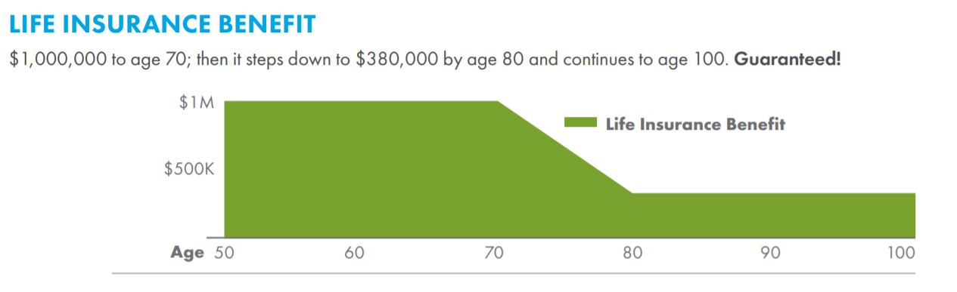
10-10-10
This hypothetical example is for illustrative purposes only. Not an actual case and intended solely to depict how the features might work. It does not reflect the value of any specific policy. Restrictions and limitations apply.
For the purpose of easing the explanation, all numbers have been rounded. The QoL Guarantee Plus II product solution is based on an illustration dated 04/16/18 for a 50 year old male, preferred non-tobacco with premiums paid for 10 years and a death benefit guaranteed to age 100. The policy included the approximately $25,000 of Lifestyle Income Solution rider, beginning at age 70 and a 100% Accelerated Access Solution rider with a 2% monthly benefit.
Notes:
The Value+ Protector offers innovative provisions for accessing excess cash value in the policy without reducing initial death benefit and in some cases increasing the death benefit.
Other options include living benefits that accelerate the death benefit, thus protecting other family assets from being depleted to support a chronic illness.
Strong Index Performance Feature
Excess Funding Feature
Accelerated Access Solution
Select Income Rider
Premium Protection Rider

Slide 16
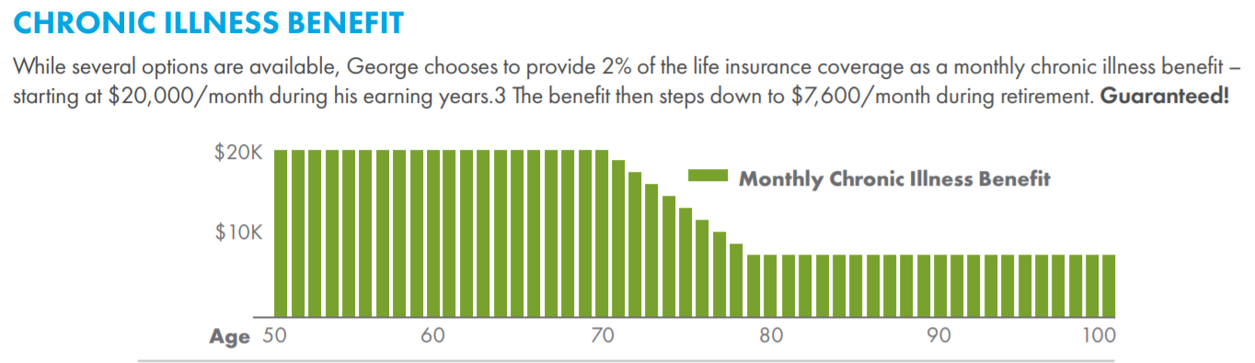
10-10-10
This hypothetical example is for illustrative purposes only. Not an actual case and intended solely to depict how the features might work. It does not reflect the value of any specific policy. Restrictions and limitations apply.
For the purpose of easing the explanation, all numbers have been rounded. The QoL Guarantee Plus II product solution is based on an illustration dated 04/16/18 for a 50 year old male, preferred non-tobacco with premiums paid for 10 years and a death benefit guaranteed to age 100. The policy included the approximately $25,000 of Lifestyle Income Solution rider, beginning at age 70 and a 100% Accelerated Access Solution rider with a 2% monthly benefit.
Notes:
The Value+ Protector offers innovative provisions for accessing excess cash value in the policy without reducing initial death benefit and in some cases increasing the death benefit.
Other options include living benefits that accelerate the death benefit, thus protecting other family assets from being depleted to support a chronic illness.
Strong Index Performance Feature
Excess Funding Feature
Accelerated Access Solution
Select Income Rider
Premium Protection Rider

Slide 17
QoL Value+ Protector
Death Benefit Focused Index Universal Life
FOR FINANCIAL PROFESSIONAL USE ONLY-NOT FOR PUBLIC DISTRIBUTION
Notes:
Read Slide

Slide 18
Target Market
An attractive bridge product between GUL and Cash Accumulation IUL
  Provides security of a guaranteed death benefit like traditional GUL products
  Flexibility and meaningful cash accumulation that is found in Index Universal Life products
Competitive, low-cost death benefit focused IUL with built-in living benefits!
“Dial-able” guarantees up to age 100!
Notes:
Read Slide

Slide 19

Excess Funding Feature
If clients pay extra premium into their policy to achieve additional tax advantaged growth, they can use this unique liquidity option to withdraw excess premiums in policy year 20 with no decrease in their initial death benefit,¹ if there is available cash surrender value in the policy.^{2, 3}
1. Option election dates are at the end of the 20th policy for issue ages 0-64 or the later of age 85 or the end of the 5th policy year for issue ages 65-85.
2. Under current federal tax law, partial withdrawals are reportable to the policy owner, and may be taxable.
3. Limitations apply.
Notes:
If clients pay extra premium into their policy to achieve additional tax advantaged growth, they can use this attractive liquidity option to withdraw excess premiums in policy year 20 with no decrease in their initial death benefit, if there is available cash surrender value in the policy.

Slide 20
Strong Index Performance Feature
If values in the policy exceed benchmark assumptions due to strong index performance, this differentiated liquidity option allows clients to withdraw the excess cash value, either in policy year 20 or at age 85 – with no decrease in the initial death benefit or length of death benefit guarantee.¹ The cash can be used as desired, or to buy additional paid-up life insurance without further underwriting.²
Option election dates are at the end of the 20th policy year (for issue ages 0-64) and the later of age 85 or the end of the 5th policy year (for all issue ages).
Under current federal tax law, partial withdrawals are reportable to the policy owner and may be taxable. Limitations apply.
Notes:
If values in the policy exceed benchmark assumptions due to strong index performance, this one-of-a-kind liquidity option allows clients to withdraw the excess cash value, either in policy year 20 or at age 85 – with no decrease in the initial death benefit or length of death benefit guarantee. The cash can be used as desired, or to buy additional paid-up life insurance without further underwriting.

Slide 21
Index Strategy Options
Index Strategy | Guaranteed Minimum Interest | Cap Rate | Participation Rate | Non-Guaranteed Crediting Rate AG 49 | Current Account Value Enhancement AVE (policy years 6+)
Blend Participation Rate | 0.00% | NA | 100% | 6.09% | 0.80%
Utilizing MLSB Index
Participation Rate | 0.00% | NA | 55% | 5.60% | 0.75%
Utilizing S&P 500
Cap Rate | 0.00% | 9.00% | NA | 5.60% | 0.75%
Utilizing S&P 500
Declared Interest | 2.00% | NA | NA | 3.25% | 0.75%
Rates current as of 09/14/2018 and subject to change.
Notes:
Read Slide

Slide 22


Scenario
Meet Jason. He’s 50 years old, married with two kids and needs $500k additional permanent life insurance coverage.
Likes the security of a GUL policy, but not the limited cash value.
Likes the growth opportunity within an IUL, but is still concerned
about guarantees.
GUL and IUL solutions:
For $467 per month, Jason’s financial professional offers him two possible solutions.
  Solution 1 offers a guaranteed death benefit, but requires a higher monthly premium.
  Solution 2 provides similar guarantees due to upside market potential while
  offering significantly more cash value growth potential.
This is not an actual case. This hypothetical example is for illustrative purposes only.

Slide 23
Solution 1: $500k Guaranteed IUL
GUARANTEED UL: QoL GUARANTEE GUL II
A monthly premium of $467
Offers guaranteed insurance coverage until age 105
Partial withdrawal capability – if Jason has built up some cash value in his policy and his needs change, he could withdraw some funds from his policy.
It’s important to note that this would result in a proportional reduction of accumulation value and death benefit. His advisor also explains there is often less cash value in the policy for retirement needs compared to an IUL.
Return of Premium option
If needs change, Jason could also receive some or all of his paid premiums
back at year 20 or 25.¹
¹ 50% in year 20, 100% in year 25, capped at 40% of the policy’s lowest specified amount.

Slide 24
Solution 2: $500k Protection IUL
PROTECTION-FOCUSED IUL: QoL VALUE+ PROTECTOR
A monthly premium of $467
Tax-advantaged cash accumulation with 3 simple index strategies to choose from. Enjoy upside market potential without downside market risk.
Guaranteed death benefit coverage until age 94.
Non-guaranteed death benefit coverage and cash value that can last Jason’s full lifetime if funded correctly.
Strong Index Performance liquidity feature allows for withdrawal of excess cash
value, after 20 years or at age 85, with no decrease in the death benefit or guarantees, if certain conditions are met.^{2, 3,4}
² Option election dates are at the end of the 20th policy year (for issue ages 0-64) and the later of
age 85 or the end of the 5th policy year (for all issue ages).
³ Paid-Up additions option is available on the Strong Index Performance Feature. Only available
for Standard or better rated clients.
⁴ Policy cash surrender value must exceed benchmark assumptions due to strong index performance.

Slide 25
Compare the solutions
CASH VALUE
DEATH BENEFIT
Issue age 45, male, preferred non-tobacco, $500k death benefit, solve for premium to guarantee GUL to age 105, full pay.
Using same premium for an IUL run at 6.09% illustrated rate, the guaranteed death benefit coverage is available until age 94 while cash value and death benefit coverage can last Jason’s entire life.
$2MM
1.5MM
1MM
500K
0
$2MM
1.5MM
1MM
500K
0
QoL Value+ Protector
QoL Guarantee Plus GUL II
$4,683,816
at age 121
QoL Value+ Protector
QoL Guarantee Plus GUL II
$4,683,816
at age 121
AGE 65
AGE 105
AGE 65
AGE 105
Summary
Jason wanted the most out of his insurance program. For $467 per month, his financial advisor provided him with two options. Which do you think he chose?
All policies in this example were illustrated for a 50-year-old male, preferred non-tobacco on 4/23/18. The Secure Lifetime GUL3 policies were illustrated as paying and guaranteed to age 105. The Value+ Protector IUL was illustrated at a 6.09% index crediting rate. Both solutions were illustrated using an monthly premium of $467. The cash value and death benefit amounts may have been rounded for ease of explanation.
This is not an actual case. This hypothetical example is for illustrative purposes only.

Slide 26
An Accelerated Death Benefit Rider (ABR) is not a replacement for Long Term Care Insurance (LTCI). It is a life insurance benefit that gives you the option to accelerate some of the death benefit in the event the insured meets the criteria for a qualifying event described in the policy. The rider does not provide long-term care insurance subject to California insurance law, is not a California Partnership for Long-Term Care program policy. The policy is not a Medicare supplement.
ABRs and LTCI provide different types of benefits. An ABR allows the insured to access a portion of the life insurance policy’s death benefit while living. ABR payments are unrestricted and may be used for any purpose. LTCI provides reimbursement for necessary care received due to the inability to perform activities of daily living or cognitive impairment. LTCI coverage may include reimbursement for the cost of a nursing home, assisted living, home health care, homemaker services, adult day care, hospice services or respite care for the primary caretaker and the benefits may be conditioned on certain requirements or meeting an elimination period or limited by type of service, the number of days or a maximum dollar limit. Some ABRs and all LTCI are conditioned upon the insured not being able to perform two or more of the activities of daily living or being cognitively impaired.
This ABR pays proceeds that are intended to qualify for favorable tax treatment under section 101(g) of the Federal Internal Revenue Code. The federal, state, or local tax consequences resulting from payment of an ABR will depend on the specific facts and circumstances, and consequently advice and guidance should be obtained from a personal tax advisor prior to the receipt of any payments. ABR payments may affect eligibility for, or amounts of, Medicaid or other benefits provided by federal, state, or local government. Death benefits and policy values, such as cash values, premium payments and cost of insurance charges if applicable, will be reduced if an ABR payment is made. ABR payments may be limited by the contract or by outstanding policy loans.
Notes:
Read Slide

Slide 27
Information about the ML Strategic Balanced Index®
The ML Strategic Balanced Index® provides systematic, rules-based access to the blended performance of two underlying indices—the S&P 500 (without dividends), which serves to represent equity performance, and the Merrill Lynch 10-year U.S. Treasury Futures Total Return Index, which serves to represent fixed income performance. To help manage overall return volatility, the Index may also systematically utilize cash performance in addition to the performance of the two underlying indices.
Important Note: The ML Strategic Balanced Index® embeds an annual index cost in the calculations of the change in Index Value over the Index Term. This “embedded index cost” will reduce any change in Index Value over the Index Term that would otherwise have been used in the calculation of index interest, and it funds certain operational and licensing costs for the index. It is not a fee paid by you or received by the Company. The Company’s licensing relationship with Merrill Lynch, Pierce, Fenner & Smith Incorporated for use of the ML Strategic Balanced Index and for use of certain service marks includes the Company’s purchase of financial instruments for purposes of meeting its interest crediting obligations. Some portion of those instruments will, or may be, purchased from Merrill Lynch, Pierce, Fenner & Smith Incorporated or its Affiliates.
Merrill Lynch, Pierce, Fenner & Smith Incorporated and its affiliates (“BofA Merrill Lynch”) indices and related information, the name “BofA Merrill Lynch”, and related trademarks, are intellectual property licensed from BofA Merrill Lynch, and may not be copied, used, or distributed without BofA Merrill Lynch’s prior written approval. The products of licensee American General Life Insurance Company have not been passed on as to their legality or suitability, and are not regulated, issued, endorsed, sold, guaranteed, or promoted by BofA Merrill Lynch.
BOFA MERRILL LYNCH MAKES NO WARRANTIES AND BEARS
NO LIABILITY WITH RESPECT TO ANY INDEX, ANY RELATED INFORMATION, ITS TRADEMARKS, OR THE PRODUCT(S)
(INCLUDING WITHOUT LIMITATION, ITS QUALITY, ACCURACY,SUITABILITY AND/OR COMPLETENESS).
The ML Strategic Balanced Index (the “Index”) is the property of Merrill Lynch, Pierce, Fenner & Smith Incorporated, which has contracted with S&P Opco, LLC (a subsidiary of S&P Dow Jones Indices LLC) to calculate and maintain the Index. The Index is not sponsored by S&P Dow Jones Indices or its affiliates or its third party licensors (collectively, “S&P Dow Jones Indices”). S&P Dow Jones Indices will not be liable for any errors or omissions in calculating the Index. “Calculated by S&P Dow Jones Indices” and the related stylized mark(s) are service marks of S&P Dow Jones Indices and have been licensed for use by Merrill Lynch, Pierce, Fenner & Smith Incorporated. Note that the ML Strategic Balanced Index™ is not available for policies issued in the State of New York.
Information about the S&P 500® Index
The S&P 500 Index is a product of S&P Dow Jones Indices LLC (“SPDJI”), and has been licensed for use by AGL and US Life. Standard & Poor’s ®, S&P® and S&P 500 ® are registered trademarks of Standard & Poor’s Financial Services LLC (“S&P”); Dow Jones® is a registered trademark of Dow Jones Trademark Holdings LLC (“Dow Jones”); and these trademarks have been licensed for use by SPDJI and sublicensed for certain purposes by AGL and US Life. AGL and US Life’s Max Accumulator+ is not sponsored, endorsed, sold or promoted by SPDJI, Dow Jones, S&P, their respective affiliates, and none of such parties make any representation regarding the advisability of investing in such product(s) nor do they have any liability for any errors, omissions, or interruptions of the S&P 500 Index.
Information about the PIMCO Global Optima Index
The PIMCO Global Optima IndexTM (the “Index”) is a comprehensive equity and bond index, offering exposure to global equity and U.S. fixed income markets. The Index is a trademark of Pacific Investment Management Company LLC (“PIMCO”) and has been licensed for use for certain purposes by American General Life Insurance Company with select life insurance and annuity products. The Index is the exclusive property of PIMCO and is made and compiled without regard to the needs, including, but not limited to, the suitability or appropriateness needs, as applicable, of the Company, the Product, or owners of the Product. The Product is not sold, sponsored, endorsed or promoted by PIMCO or any other party involved in, or related to, making or compiling the Index. PIMCO does not provide investment advice to the Company with respect to the Product or to owners of the Product.
Neither PIMCO nor any other party involved in, or related to, making or compiling the Index has any obligation to continue to provide the Index to the Company with respect to the Product. Neither PIMCO nor any other party involved in, or related to, making or compiling the Index makes any representation regarding the Index, Index information, performance, annuities generally or the Product particularly.
PIMCO disclaims all warranties, express or implied, including all warranties of merchantability or fitness for a particular purpose or use. PIMCO shall have no responsibility or liability whatsoever with respect to the Product.
The Licensed PIMCO Licensed Index is comprised of a number of constituents, some of which are owned by entities other than PIMCO. The Licensed PIMCO Indices rely on a variety of publicly available data and information and licensable equity and fixed income sub-indices. All disclaimers referenced in the Agreement relative to PIMCO also apply separately to those entities that are owners of the constituents of the Licensed PIMCO Indices. The constituents of the Licensed PIMCO Indices include: MSCI Inc., FTSE International Limited, FTSE TMX Global, Debt Capital Markets, Inc., Frank Russell Company and certain ETFs. The Licensee expressly agrees to include the following disclaimer and limited language in connection with the use of the Licensed PIMCO Indices for the Permitted Purposes.
Carriers mentioned in the presentation are peer group competitors of American General Life. Every attempt has been made to verify the accuracy of competitor information included in this presentation. Product information and rates are subject to change at any time.
Policies issued by: American General Life Insurance Company (AGL), Houston, TX Policy Form Numbers: 15646, ICC15-15646; Rider Form Numbers: 13600-5, 15600-7, 15600, ICC15-15600, 15600-5, 13601, ICC13-13601, 82012, 82410, 88390, 14002, ICC14-14002, 14306, 07620, 15997, 15996, 15271, ICC15-15271, 15274, ICC15- 15274, 15272, ICC15-15272, 15273, ICC15-15273. Issuing company AGL is responsible for financial obligations of insurance products and is a member of American International Group, Inc. (AIG). AGL does not solicit business in the state of New York. Products may not be available in all states and product features may vary by state. Guarantees are backed by the claims-paying ability of the issuing insurance company. AIG is the marketing name for the worldwide property-casualty, life and retirement, and general insurance operations of American International Group, Inc. For additional information, please visit our website at www.aig.com. All products and services are written or provided by subsidiaries or affiliates of American International Group, Inc. Products or services may not be available in all countries, and coverage is subject to actual policy language. This information is general in nature, may be subject to change, and does not constitute legal, tax or accounting advice from any company, its employees, financial professionals or other representatives. Applicable laws and regulations are complex and subject to change. Any tax statements in this material are not intended to suggest the avoidance of U.S. federal, state or local tax penalties. For advice concerning your individual circumstances, consult a professional attorney, tax advisor or accountant.
AGLC111990 ©2018 AIG. All rights reserved. FOR FINANCIAL PROFESSIONAL USE ONLY-NOT FOR PUBLIC DISTRIBUTION
Notes:
Read Slide

Slide 28
Thank YOU!
Notes:
Thank you for your time today. Please let us know if you have any questions.

